Slide 1

Analyzing The Canadian Aviation Market
November 2024
By: Giselle Dos Santos

Slide 2
Analysis of the Canadian Aviation Market
Exploring Seat capacity and operational patterns
Objectives:
To analyze the distribution of seat capacity across various operations in the Canadian Market
To explore how different factors impact seat allocation and operational efficiency
Key Variables:
Month
Operational Airline Capacity
Departure Count
Distance
Seats per Operation
Research Questions:
How do various operational factors, such as departure frequency, flight distance, and airline capacity, influence seat allocation patterns in the Canadian Aviation Market, and what insights can be drawn to improve resource planning and operational efficiency?
Analysis Goal:
This question is essential to understanding operational efficiencies and capacity planning within the aviation sector. By answering it, I aim to provide insights that could support strategic decisions regarding fleet management, route planning, and demand forecasting

Slide 3
Dataset Overview and Key Variables
Source: SABRE Market Intelligence – Canada Schedules
Key Variables:
Month: Captures seasonality in flight demand.
Operating Airline Capacity: Measures total seats allocated per flight.
Departure Count (DepCount): Represents the frequency of flights.
Distance (km): Denotes route length, potentially influencing seat allocation.
Seats per Operation: Average seats per flight, indicating capacity utilization.
Purpose of the Variables:
The variables were selected to examine the relationship between seat allocation and factors like seasonality, frequency, capacity, and route distance

Slide 4
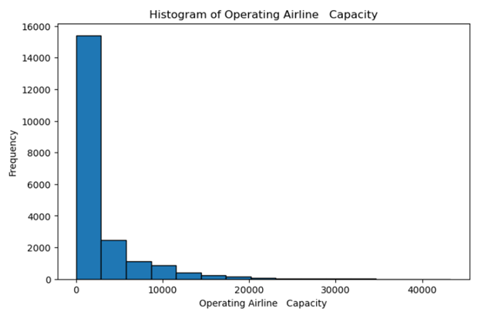
Histogram and Analysis of Operating Airline Capacity
Provides insight into the frequency and spread of airline capacities across different operations
Descriptive Statistics:
Mean: 5,124.37 pax
Mode: 1,500 pax
Standard Deviation: 8,376.21
Min: 0 pax
Max: 44,000 pax
Outliers:
Upper Bound: 15,540 pax
Routes with capacity above this limit might represent routes that utilize high-capacity aircraft or special routes.
Interpretation:
This histogram shows a right-skewed distribution, with most operations having low operating capacities. This suggests that the Canadian aviation market may have a significant number of small-capacity flights, likely due to regional or short-haul routes.

Slide 5
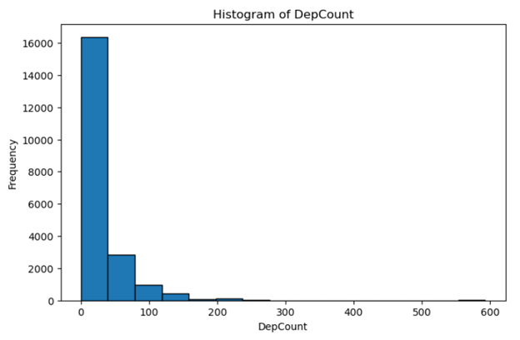
Histogram and Analysis of Departure Count
Reveals patterns in flight frequency across different operations
Descriptive Statistics:
Mean: 21.12 Departures
Mode: 1 Departure
Standard Deviation: 45.56
Min: 0
Max: 583
Outliers:
Upper Bound: 87.5
Routes with more than 87 departures are most likely high demand routes or hubs that have high frequency of service
Interpretation:
The histogram for DepCount reveals a concentration of low-departure frequencies, with a few instances of high-departure counts. This skewed distribution indicates that most routes have limited frequency, but a few high-demand routes see more frequent service.

Slide 6
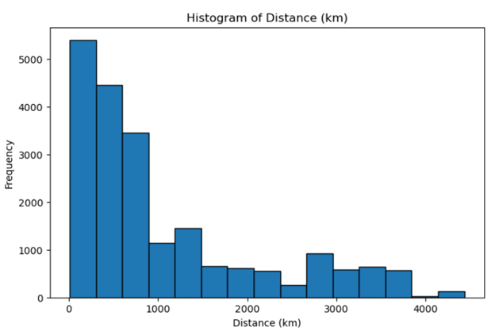
Histogram and Analysis of Distance
Provides insight into the prevalence of short-haul vs. long-haul operations
Descriptive Statistics:
Mean: 972.35k m
Mode: 500 km
Standard Deviation: 1,120.87
Min: 0 km
Max: 4,710 km
Outliers:
Upper bound: 2,350 km
These routes could represent special long-haul routes or international operations that differ significantly from most short-haul flights in the dataset. If included in general analyses, these outliers could overestimate average flight distance.
Interpretation:
The distance histogram is right-skewed, with a high frequency of shorter flights. This aligns with the nature of the Canadian market, where regional or short-haul flights are more common than long-haul operations.

Slide 7
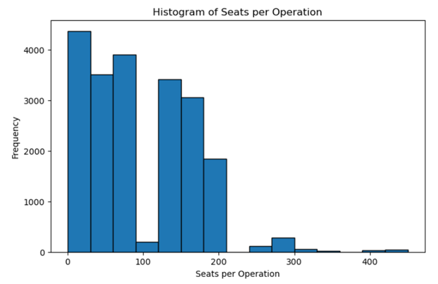
Histogram and Analysis of Seats per Operation
Displays the distribution of Seats per Operation, showing the frequency of various seat counts
Descriptive Statistics:
Mean: 110 seats
Mode: 78 seats
Standard Deviation: 72.45
Min: 0 seats
Max: 450 seats
Outliers:
Upper bound: 260 seats
Operations with seat counts over 260, likely representing larger aircraft or high-demand flights. These outliers could inflate the average seat count if not handled carefully in analyses focused on typical flight operations.
Interpretation:
This histogram shows that most operations have fewer seats, with a right-skewed distribution. The small number of high-seat operations may represent flights with larger aircraft used on high demand or long-haul routes.

Slide 8
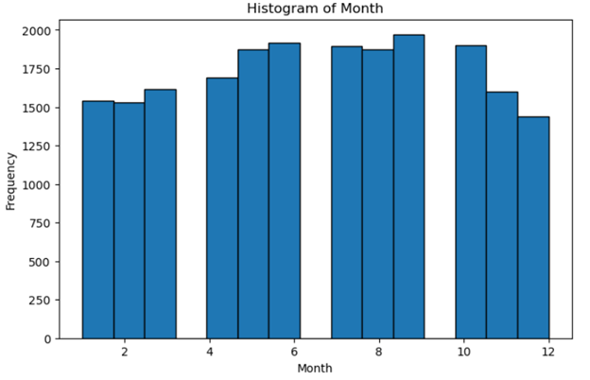
Histogram and Analysis of Months
Visualizes the monthly distribution of operations, highlighting any seasonal trends
Descriptive Statistics:
Mode: August (7)
Spread: Seasonal variability in operations.
Outliers:
This variable doesn’t have an outlier since you can operate outside of the 12-month year
Any months with noticeably higher or lower frequencies could indicate seasonal demand changes. For example, summer or holiday months might see spikes, while other times could see declines, affecting operational planning.
Interpretation:
The distribution across months is relatively consistent, suggesting steady aviation activity throughout the year. Any slight fluctuations could indicate seasonal trends but appear minimal in this dataset.

Slide 9
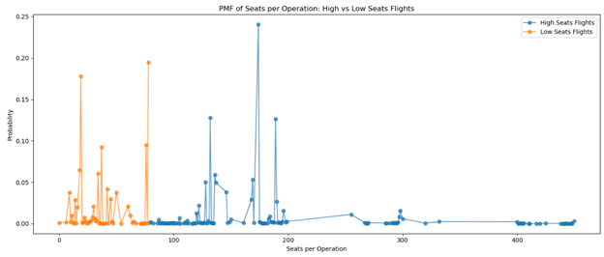
PMF of Seats per Operation: High vs Low Seats Flights
PMF comparison for flights with high and low seats, based on median seat count
The PMF comparison shows that low-seat flights have higher frequencies, while high-seat flights are less common.
This split suggests different operational categories—perhaps smaller aircraft for regional routes and larger aircraft for high demand and long-haul routes.

Slide 10
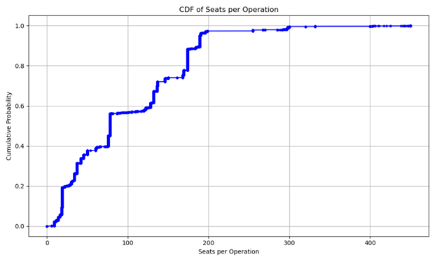
CDF of Seats per Operation
CDF of seat counts per operation, showing cumulative probabilities
The CDF reveals cumulative probabilities for seat counts, indicating that a large proportion of flights have fewer than 200 seats.
The shape of the CDF also suggests clustering around certain seat levels, possibly due to airlines fleet capacities.

Slide 11
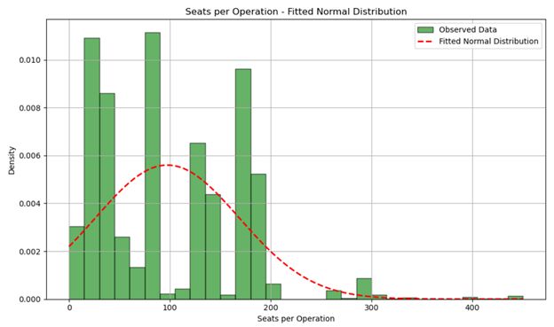
Seats per Operation - Fitted Normal Distribution
The distribution shows multiple peaks and right skews
The observed data deviates significantly from a normal distribution, particularly with multiple peaks.
This pattern indicates a heterogeneous mix of operations, likely due to the use of different aircraft sizes for varied routes
High-capacity operations are likely the cause behind the normal fit being distorted

Slide 12
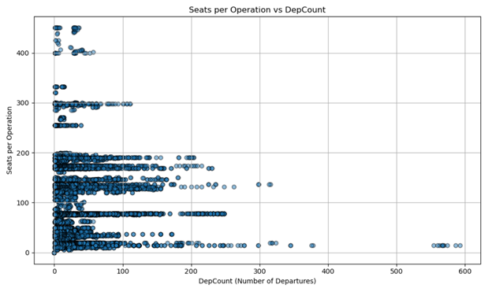
Scatter Plot: Departure Count vs Seats per Operation
Relationship between DepCount and Seats per Operation
The scatter plot shows little to no strong correlation between departure count and seats per operation, as indicated by the low Pearson correlation.
This suggests that route frequency doesn’t necessarily correlate with higher seating capacity

Slide 13
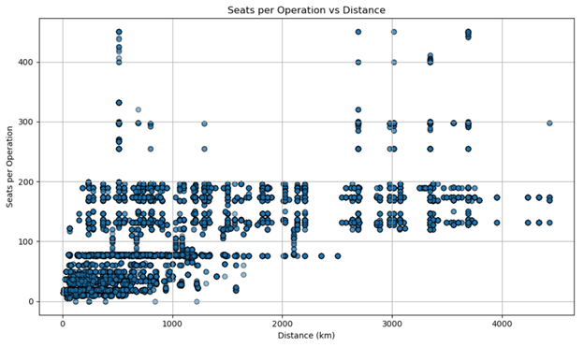
Scatter Plot: Distance vs Seats per Operation
Relationship between Distance (km) and Seats per Operation
There appears to be some clustering for flights under 1000 km with lower seat counts.
The weak correlation indicates that many shorter flights operate with high seating capacities, most likely due to high-demand short-haul routes

Slide 14
Hypothesis Test on Seats per Operation
T-test on mean seats for high vs. low departure operations
Research Hypothesis:
Null Hypothesis
The mean number of seats per operation is the same for flights with high and low departure counts
Alternative Hypothesis
The mean number of seats per operation differ significantly between flights with high and low departure counts
Methodology:
Grouping:
Flights were divided by high (> median) and low (</= Median) departure counts
Test Type:
The mean seats per operation for the two groups was compared using a two-sample independent t-test
Results:
T-Statistics: -10.84
P-Value: 2.62 x 10^-27
Decision:
The P-Value is far below the significant level of 0.05, so the null hypothesis is rejected
Interpretation of Results:
The results show that seat allocation strategies differ depending on departure frequencies.

Slide 15
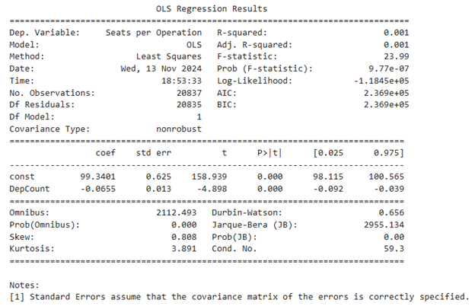
Regression Analysis of DepCount and Seats per Operation
Can the Departure Count predict the Seats per Operation?
The low R-squared value in the regression analysis suggests that departure count alone is not a good predictor of seats per operation.
Other factors such as distance or market demand may better explain seat allocation

Slide 16

THANK YOU

